Slide 1

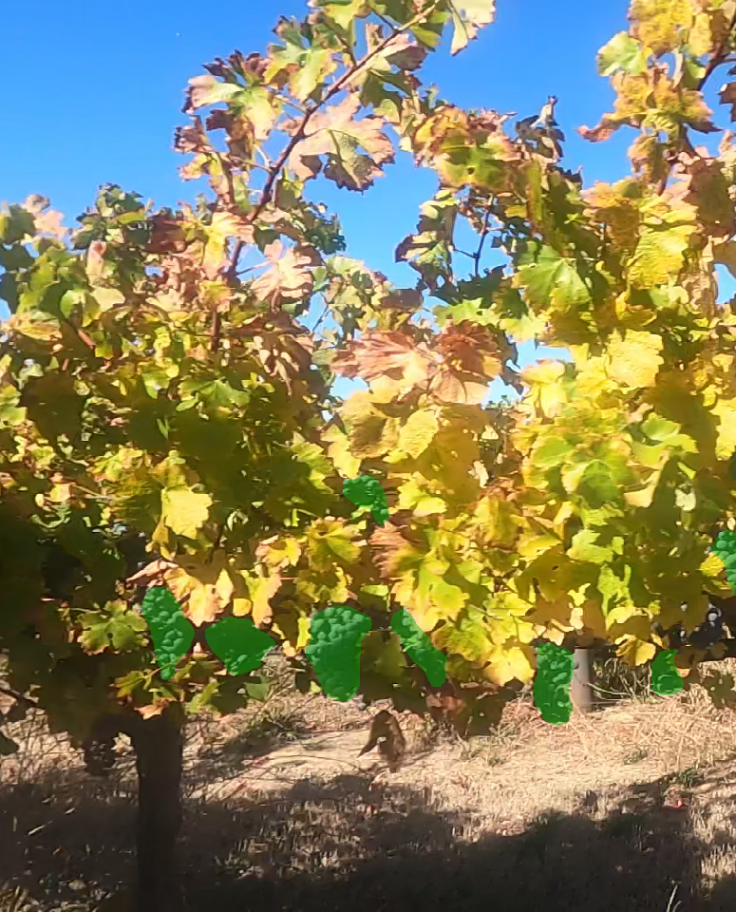
Grape Instance Segmentation
Total number of objects - 12
Allayvity
TEAM SIZE - 4
TEAM LEAD - HARSHIT BAJETA
CONTACT NO - 7668510979
EMAIL ID - harshitbajeta22@gmail.com
COLLEGE NAME - GRAPHIC ERA UNIVERSITY
EXPLORE AI 2.0 HACKATHON

Slide 2
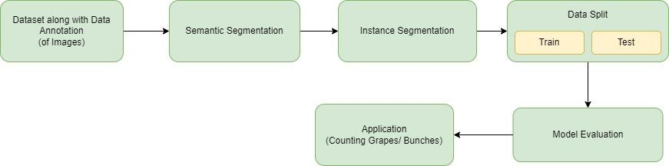
TECHNICAL ARCHITECTURE
Tech Stack:
Sklearn for mathematical computation
Tensorflow DL
Numpy matplotlib for DL
Python programming Language
Jupyter Notebook

Slide 3
SOLUTION AND TECHNICAL DETAILS
Data collection and Annotation (of images).
Transforming our data to instance Segmentation Annotation(.NPZ format).
Splitting the data for training and testing.
Detecting the bunches of grapes by following the techniques mentioned in previous flowchart (Mask R-CNN).bhai bas kar submit krdiya h
Evaluation of model by calculating mAP, precision and recall.
Application:
We know that viticulture is based on high-tech stack and this model will be a boon for viticulture as we will be able to detect and count number of bunches with the help of deep learning.

